Slide 1

Server programming
Iterators (CA)

Slide 2

Team Member’s
*Siddharth Chauhan. *Mahib Mridha. *Arpit Khandelwal.
*Siddharth Chauhan
*

Slide 3
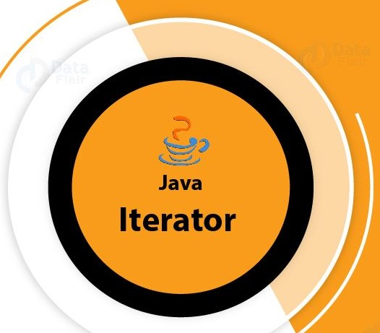
java Iterator
The Java Iterator interface represents an object capable of iterating through a collection of Java objects, one object at a time. The Iterator interface is one of the oldest mechanisms in Java for iterating collections of objects (although not the oldest - Enumerator predated Iterator).
It is used to traverse a collection object elements one by one.
It is available since Java 1.2 Collection Framework.
It is applicable for all Collection classes. So it is also known as Universal Java Cursor.
It supports both READ and REMOVE Operations.
Compare to Enumeration interface, Iterator method names are simple and easy to use.

Slide 4
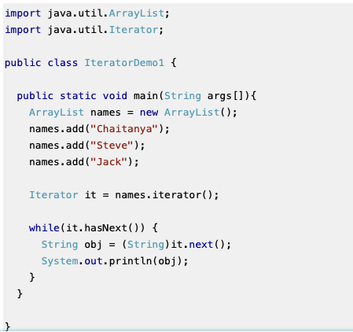

Java Iterator Basic Example

Slide 5

Obtaining an Iterator & Java Iterator Methods
Most often that is how you will interact with an Iterator by obtaining it from some Java object that contains multiple nested objects. The standard Java collection interface Collection contains a method called iterator(). By calling iterator() you can obtain an iterator from the given Collection.
You can also obtain an Iterator from many of the Java Collection data structures, e.g. a List, Set, Map, Queue, Deque or Map.
In this section, we will discuss about Java Iterator methods in-brief. We will explore these methods in-depth with some useful examples in the coming section.
boolean hasNext():Returns true if the iteration has more elements.
E next(): Returns the next element in the iteration.
default void remove(): Removes from the underlying collection the last element returned by this iterator.
default void forEachRemaining(Consumer action): Performs the given action for each remaining element until all elements have been processed or the action throws an exception.

Slide 6
Iterating an Iterator & Iteration Order
The order in which the elements contained in a Java Iterator are traversed depends on the object that supplies the Iterator. For instance, an iterator obtained from a List will iterate through the elements of that List in the same order the elements are stored internally in the List. An Iterator obtained from a Set, on the other hand, does not make any guarantees about the exact sequence the elements in the Set are iterated in.
You iterate the objects in an Iterator using a while loop. Here is an example of iterating the elements of a Java Iterator using a while loop:
There are two methods to pay attention to in the above Java example. The first method is the Iterator hasNext() method which returns true if the Iterator contains more elements. In other words, if the Iterator has a next element.
The second method to pay attention to is the next() method. The next() method returns the next element of the collection the Iterator traverses.

Slide 7
Java List Iterator & Java Set Iterator

Slide 8
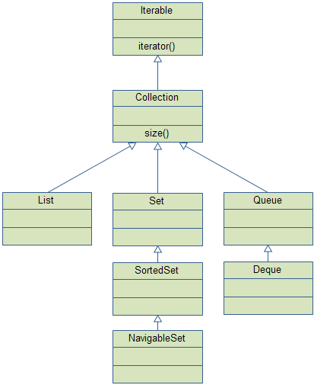
Java Collections - Overview
In order to understand and use the Java Collections API effectively it is useful to have an overview of the interfaces it contains. So, that is what I will provide here.
There are two "groups" of interfaces: Collection's and Map's.
Here is a graphical overview of the Collection interface hierarchy:

Slide 9
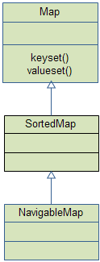
And here is a graphical overview of the Map interface hierarchy:
You can find links to explanations of most (if not all) of these interfaces and implementations in the sub-menu at the top right of this page. That top-menu exists on all pages in this trail.

Slide 10
Java - How to Use Iterator?

Slide 11
The Methods Declared by Iterator/ The Methods Declared by ListIterator

Slide 12
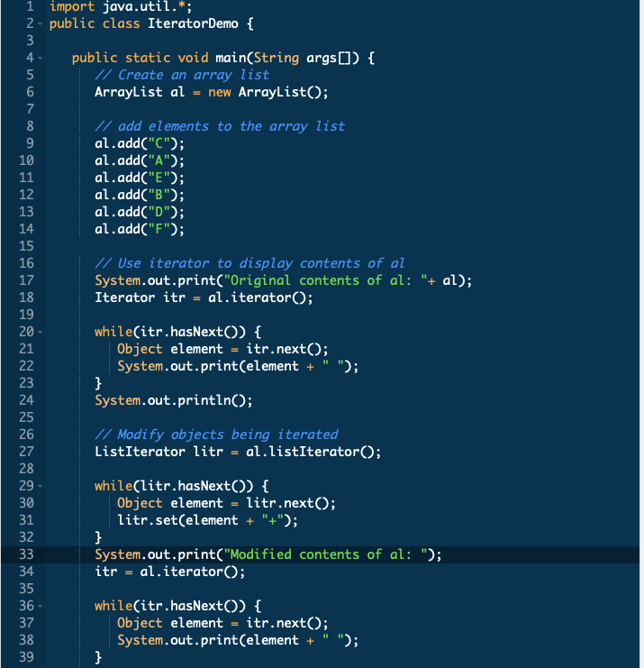
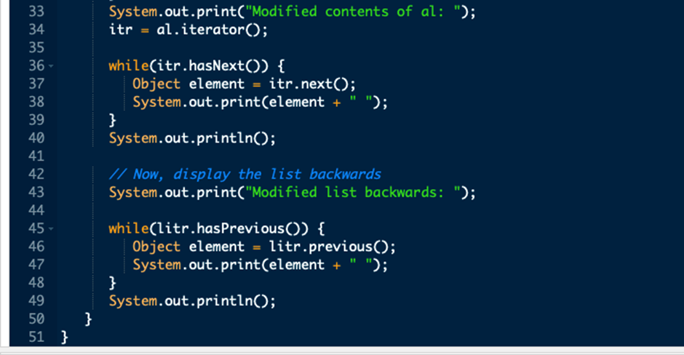
Example
Here is an example demonstrating both Iterator and ListIterator. It uses an ArrayList object, but the general principles apply to any type of collection.
Of course, ListIterator is available only to those collections that implement the List interface.

Slide 13
The Iterator Interface
To start, we need to obtain an Iterator from a Collection; this is done by calling the iterator() method.
For simplicity, we'll obtain Iterator instance from a list:
1
2 List<String> items = ...
Iterator<String> iter = items.iterator();
The Iterator interface has three core methods:

Slide 14
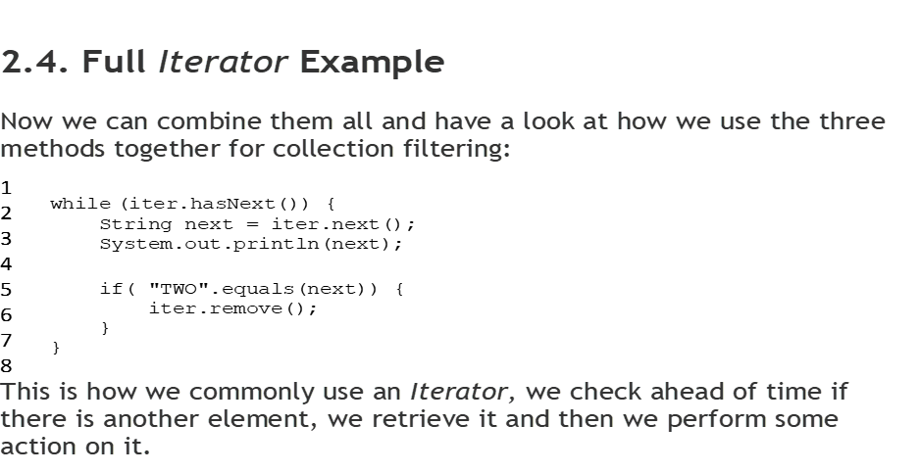

Slide 16

THANK YOU

